Slide 1
3.3 Data storage
Common types of secondary storage

Slide 2



Common types of storage
Drive: The device that reads and writes data from secondary storage.
Magnetic + drive = Magnetic drive
Solid-state + drive = Solid-state drive
Optical + drive = Optical drive

Slide 3
Common types of storage
Drive: The device that reads and writes data from secondary storage.
Media: What the data is actually stored on.
Magnetic + drive = Magnetic drive
Solid-state + drive = Solid-state drive
Optical + drive = Optical drive

Slide 4



Common types of storage
Storage devices
Optical
Magnetic
Solid-state/flash

Slide 5
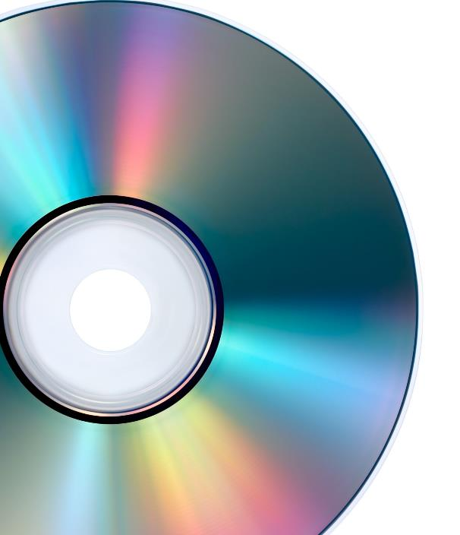

SLR3 Input, output and storage | Magnetic, flash and optical storage
OCR H046/H466
Optical storage
Pits
Lands

Slide 6

SLR3 Input, output and storage | Magnetic, flash and optical storage
OCR H046/H466
Optical storage
label
protective layer
land
pit
base
laser

Slide 7
SLR3 Input, output and storage | Magnetic, flash and optical storage
OCR H046/H466
Optical storage
Positives
Cheap
Lightweight
Portable
label
protective layer
land
pit
base
laser

Slide 8
SLR3 Input, output and storage | Magnetic, flash and optical storage
OCR H046/H466
Optical storage
Positives
Cheap
Lightweight
Portable
Negatives
Slow access times
Prone to scratches
label
protective layer
land
pit
base
laser

Slide 9
Common types of storage
Storage devices
Optical
Magnetic
Solid-state/flash

Slide 10
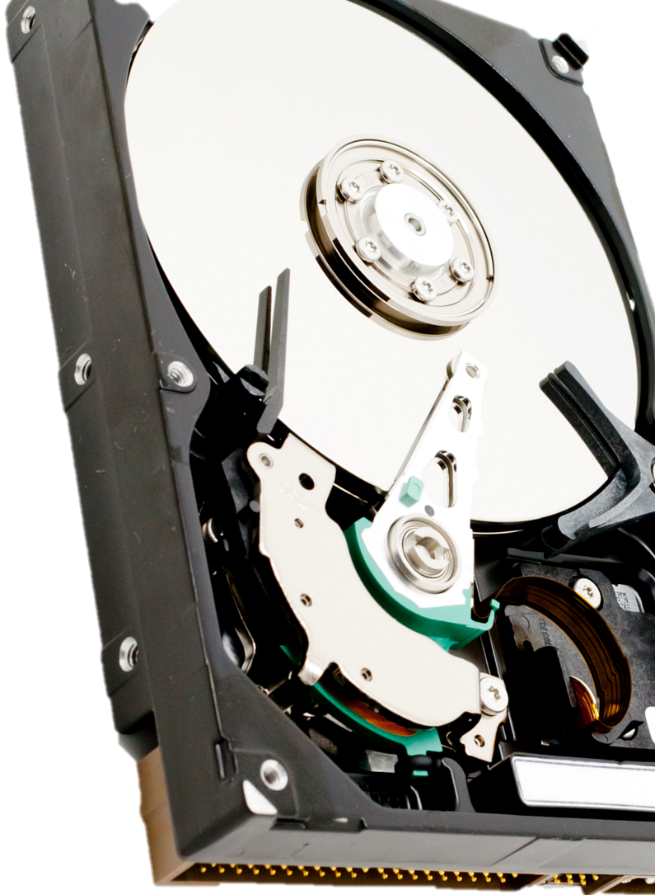
Magnetic storage
N
S
S
N
0
1

Slide 11
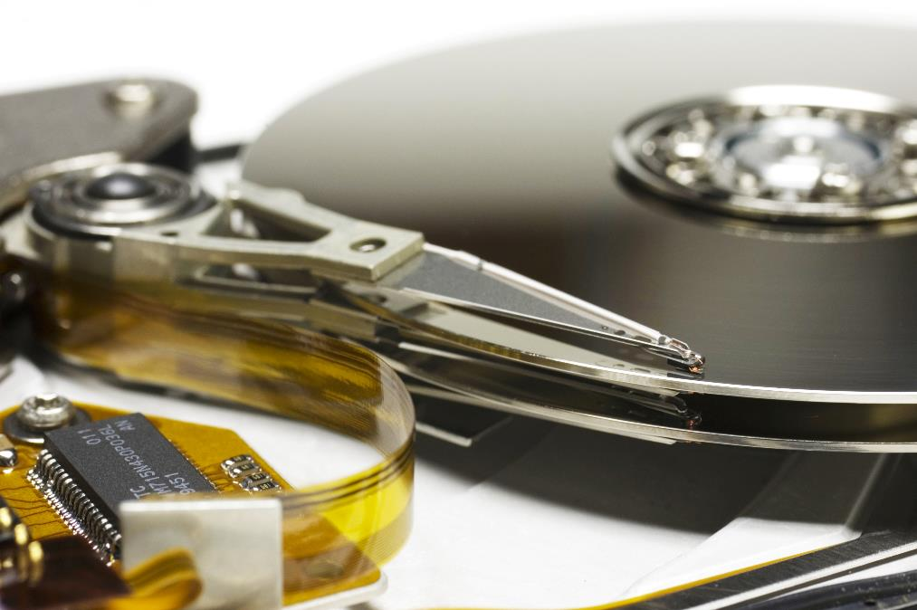

Magnetic storage
Dust
Human hair
Drive head
Disk
Smoke particle
Fingerprint

Slide 12
Magnetic storage
Magnetic storage
Positives
Cheap
Large capacity
Dust
Human hair
Drive head
Disk
Smoke particle
Fingerprint

Slide 13
Magnetic storage
Magnetic storage
Positives
Cheap
Large capacity
Negatives
Slow access times
Fragile
Dust
Human hair
Drive head
Disk
Smoke particle
Fingerprint

Slide 14
Common types of storage
Storage devices
Optical
Magnetic
Solid-state/flash

Slide 15
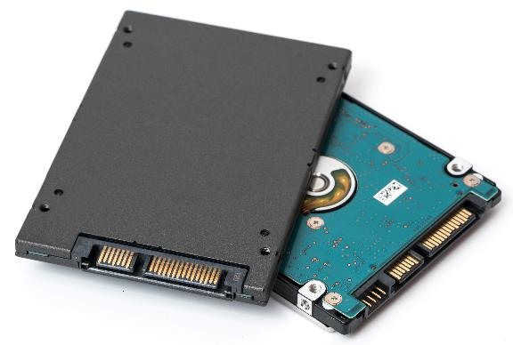
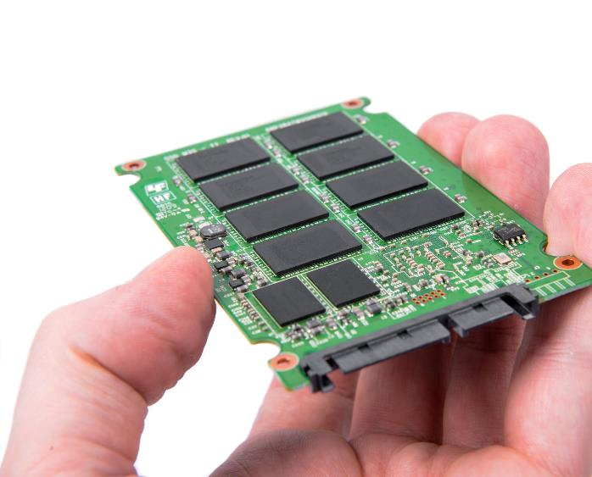
Solid-state/flash storage
Oxide layer
floating gate
Oxide layer

Slide 16
Solid-state/flash storage
Oxide layer
floating gate
Oxide layer

Slide 17
Solid-state/flash storage
Oxide layer
floating gate
Oxide layer
Positives
Durable
Fast access times

Slide 18
Solid-state/flash storage
Oxide layer
floating gate
Oxide layer
Positives
Durable
Fast access times
Negatives
Cost
Limited read/write cycles

Slide 19



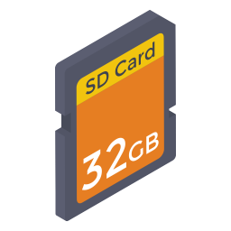



Suitable storage for specific applications
Magnetic
Optical
Solid state/flash
Hard disk drive, tape
CD-R/RW, DVD-R/RW, Blu-ray
SSD, memory sticks, flash memory cards

Slide 20

Suitable storage for specific applications
Scenario: Helmet-mounted action camera.

Slide 21

Suitable storage for specific applications
Scenario: Home computer storing operating system and applications.

Slide 22

Suitable storage for specific applications
Scenario: Distributing a video game for a console.

Slide 23

Suitable storage for specific applications
Scenario: Storing tracks on a portable MP3 player.

Slide 24

Secondary storage
Optical (CD-R/RW, DVD-R/RW, Blu-ray)
Low capacity compared to other types of storage.
Slower access speeds.
Thin, lightweight and portable.
Magnetic (hard disk drive, tape)
High storage capacity.
Faster access speeds.
Has moving parts that will eventually fail.
Hard disks perform better if they are defragmented.
Solid-state (SSD, memory stick, flash memory card)
Medium storage capacity.
Fastest access speeds.
No moving parts, so they are very reliable.
No noise.
Low power usage.
Eliminates the need for defragmentation.
Limited number of write cycles.
Expensive compared to other types of storage.

Slide 25


